Slide 1


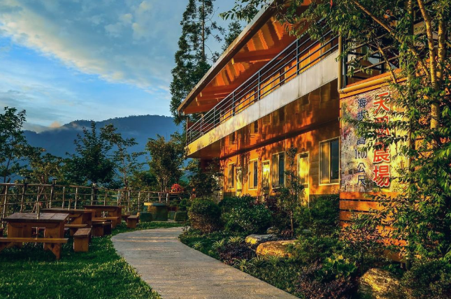
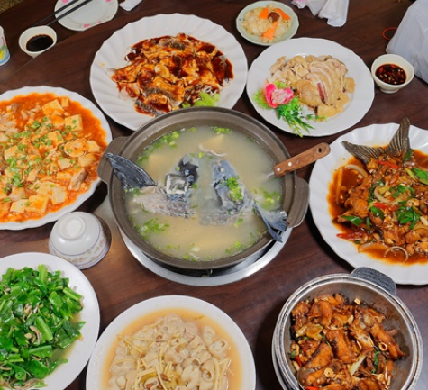
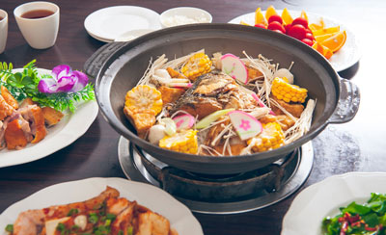

Excursion in Taiwan THz summer workshop
June 27-28 (Friday-Saturday), 2025
Schedule – Day 1
16:00 Departure from NYCU (G-map)
Light snack (dessert box) provided on the bus
16:00 – 17:00 Transfer to Shimen Reservoir and enjoy the sunset view (G-map)
17:30 – 19:00 Multi-course dinner featuring fresh local fish 十一份 (G-map)
19:00 – 20:00 Tour of the dam–enjoy the night view (G-map)
20:00 – 21:30 Travel to farmhouse guesthouse 達觀農場 (G-map)
Shimen Reservoir
Farmhouse in mountain
Taiwan
Multi-course dinner
Lalashan

Slide 2

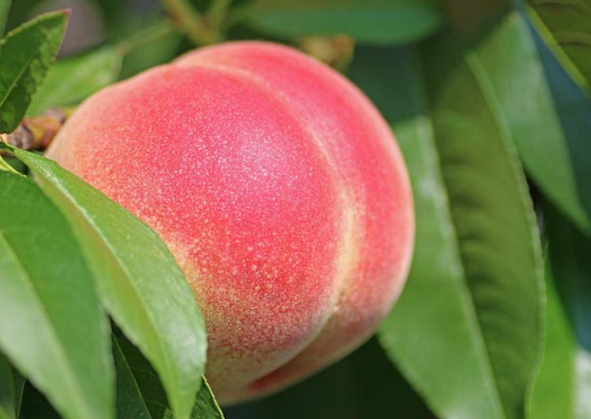
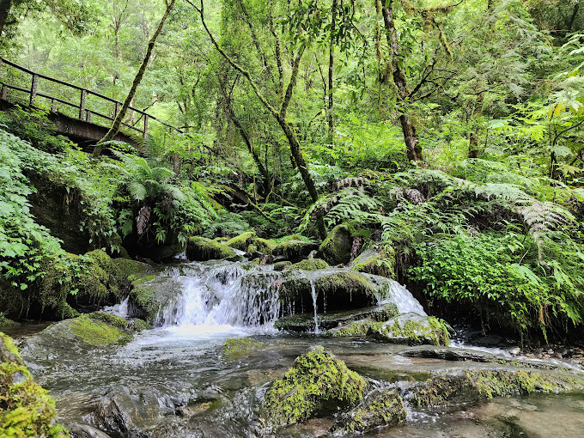
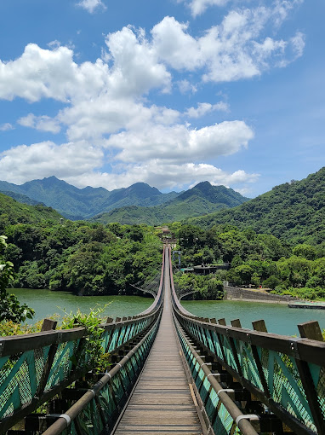

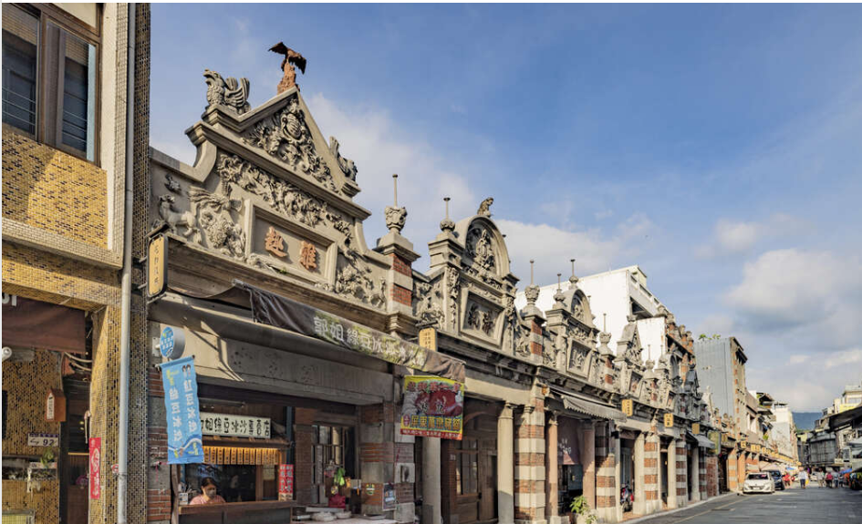
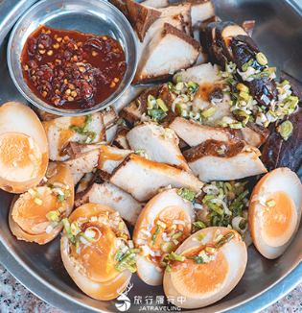
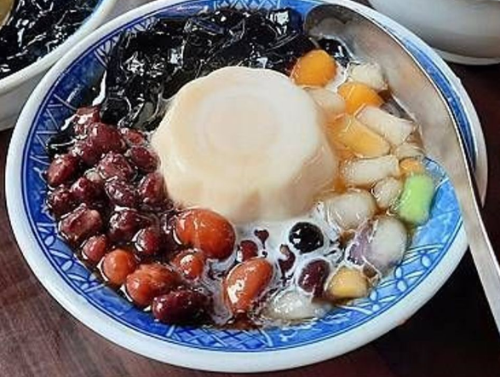
Excursion in Taiwan THz summer workshop
June 27-28 (Friday-Saturday), 2025
Schedule – Day 2
07:00 – 08:00 Breakfast
08:00 – 11:00 Tour of Lalashan Giant Trees Park (G-map)
10:00 – 11:00 Fruit picking experience (seasonal: peaches)
11:00 – 13:00 Lunch at ​Luo Fu (G-map)
13:00 – 14:00 Tour of Jiaobanshan Residence (G-map)
or Xiao Wulai Skywalk (G-map)
14:00 – 15:30 Visit to Cihu Mausoleum (G-map)
15:30 – 17:00 Stroll through Daxi Old Street with local dessert tasting (G-map)
17:00 –Return to NYCU (G-map)
or Taoyuan international airport (G-map)
Lalashan Gaint Trees Parks
Jiaobanshan Residence
Daxi Old Street

